Slide 1
Couchbase Metrics
Daniel Bashary

Slide 2
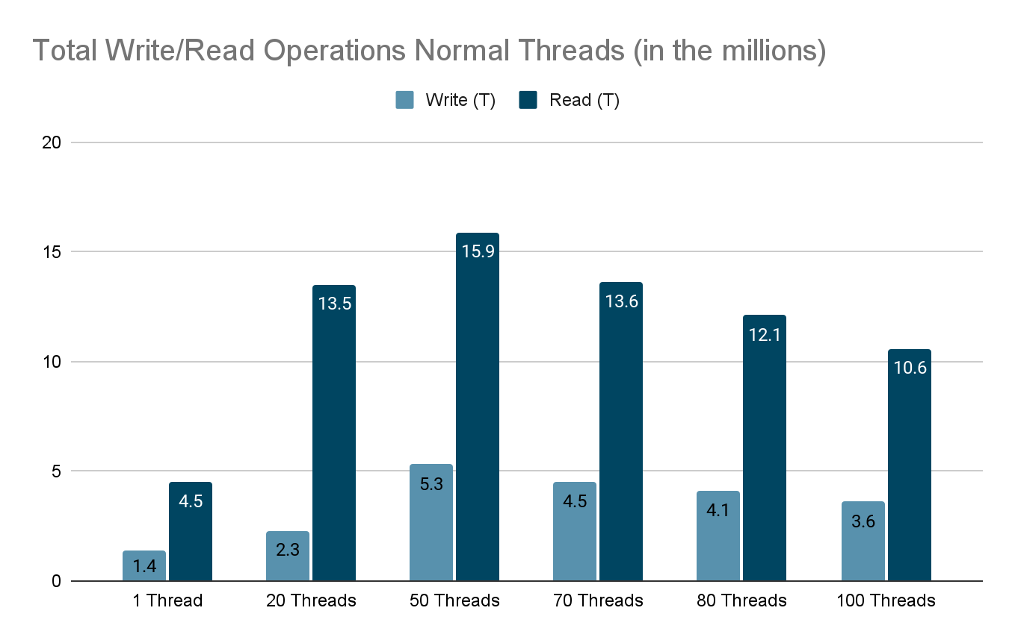

Slide 3
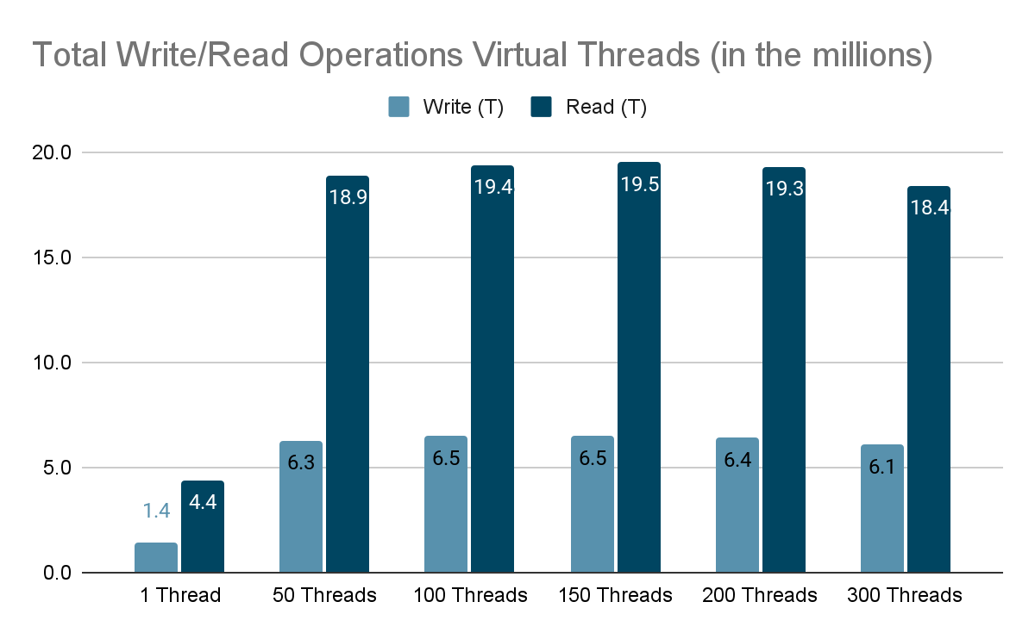

Slide 4
Total Write and Read Operations
Normal Threads
Performance shows an upward trend up to 50 threads, followed by a decline.
Peak performance is reached at 15.9 operations.
Virtual Threads
Performance improves up to 150 threads, with a decline starting around 200 threads.
Virtual threads reach a peak performance of 19.5 operations.
The peak for virtual threads is significantly higher (19.5 operations) compared to normal threads (15.9 operations), due to their ability to handle more operations efficiently before hitting a point of diminishing returns.

Slide 5
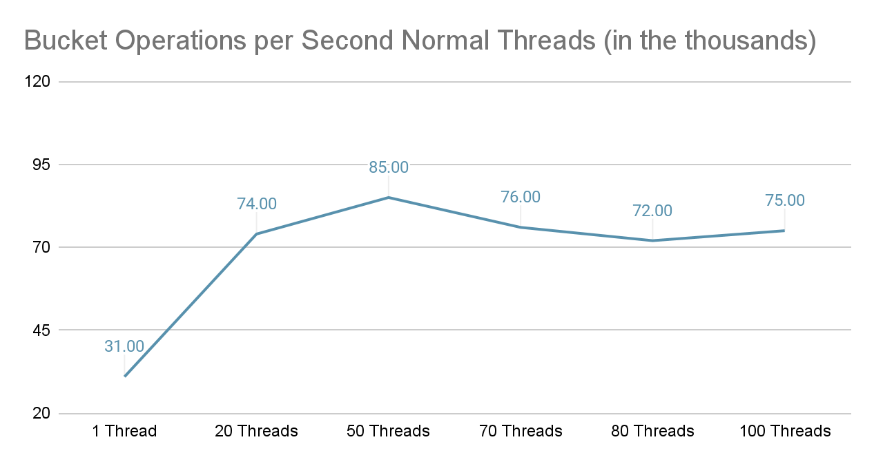

Slide 6
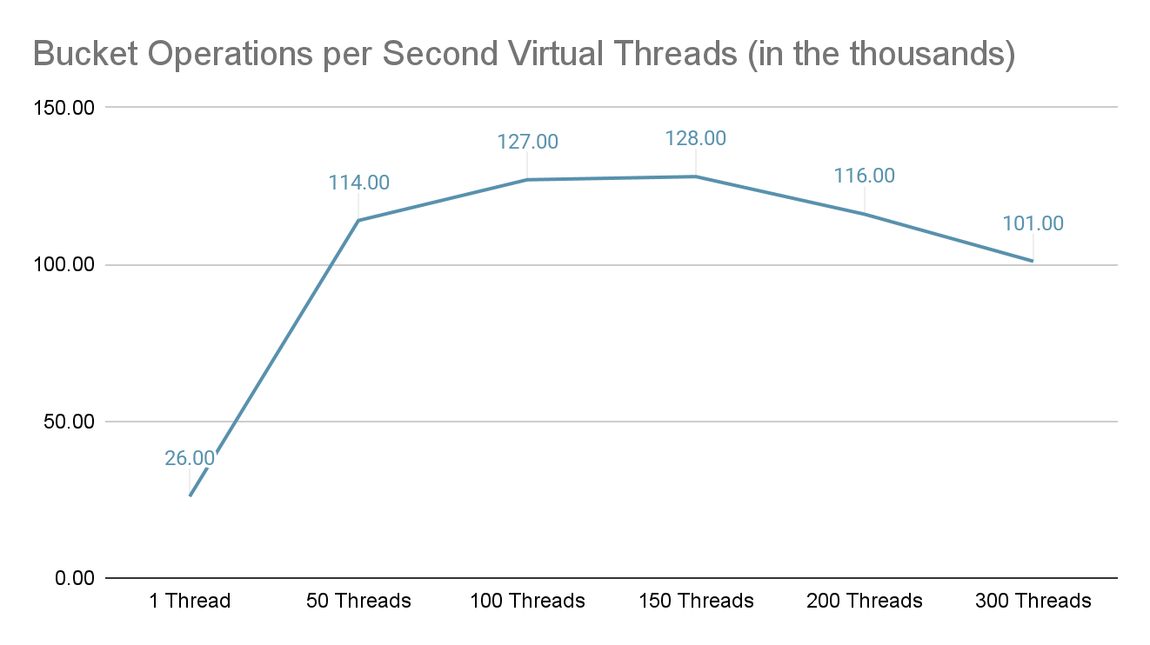

Slide 7
Operations per Second
Virtual Threads
Throughput peaks at 150 threads, reaching 128,000 operations per second. Decline in performance past this point.
Normal Threads
Throughput peaks at 50 threads, reaching 85,000 operations per second. Decline in performance past this point.
These results align with the read/write operations bar graph, showing a clear advantage for virtual threads in handling higher loads.

Slide 8
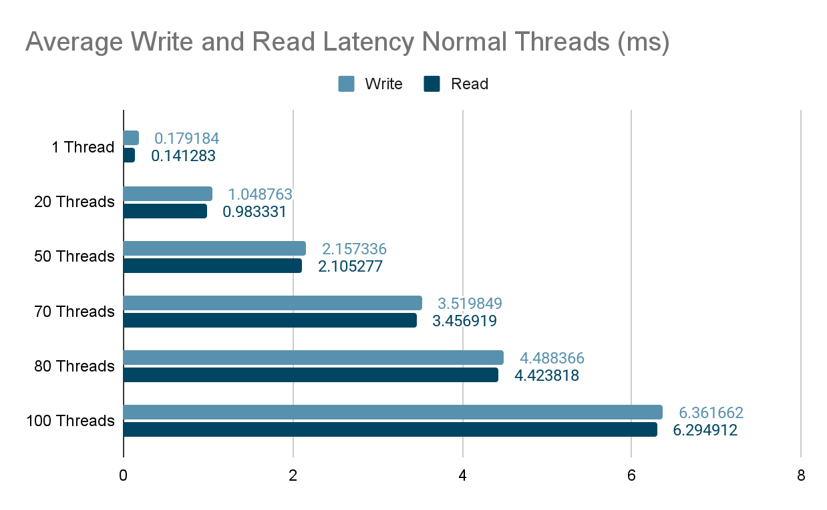

Slide 9
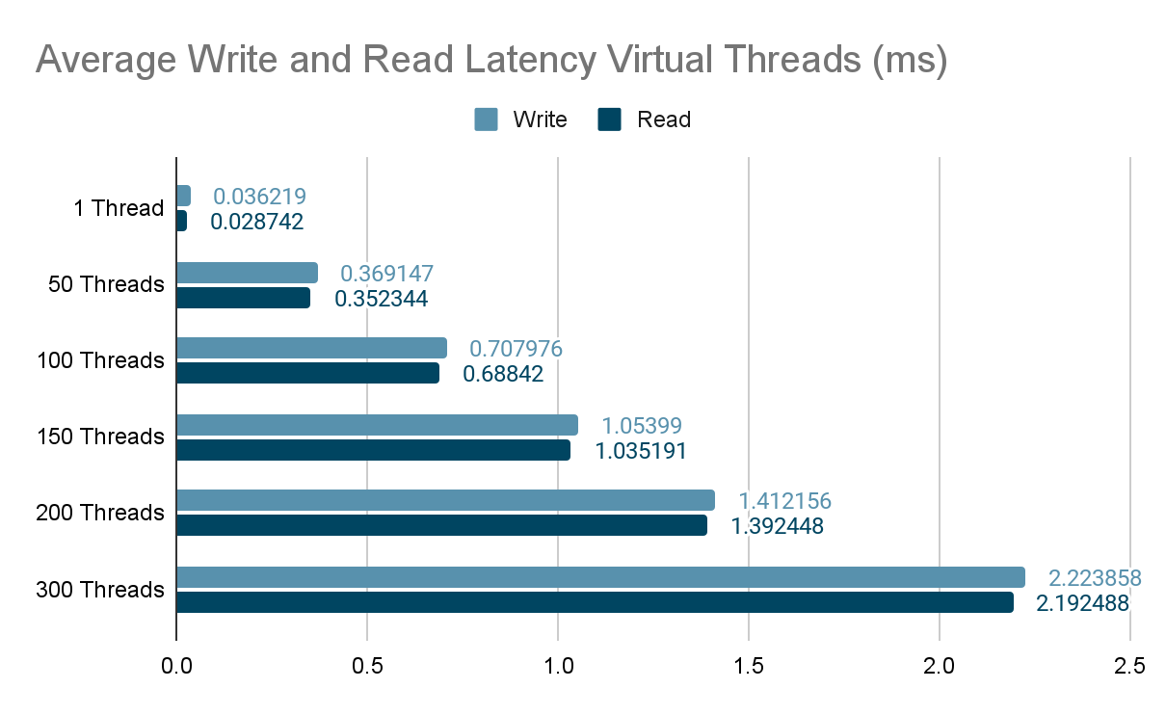

Slide 10
Average Write and Read Latency
Normal Threads
Latency increases significantly as the number of threads rises, especially beyond 50 threads.
Virtual Threads
Latency remains relatively low and increases slowly, even as the thread count grows to higher values.
Normal threads overload the system more quickly, consuming more resources and leading to higher latencies as thread counts increase. In contrast, virtual threads handle higher loads more efficiently, maintaining lower latency even with a large number of threads.

Slide 11
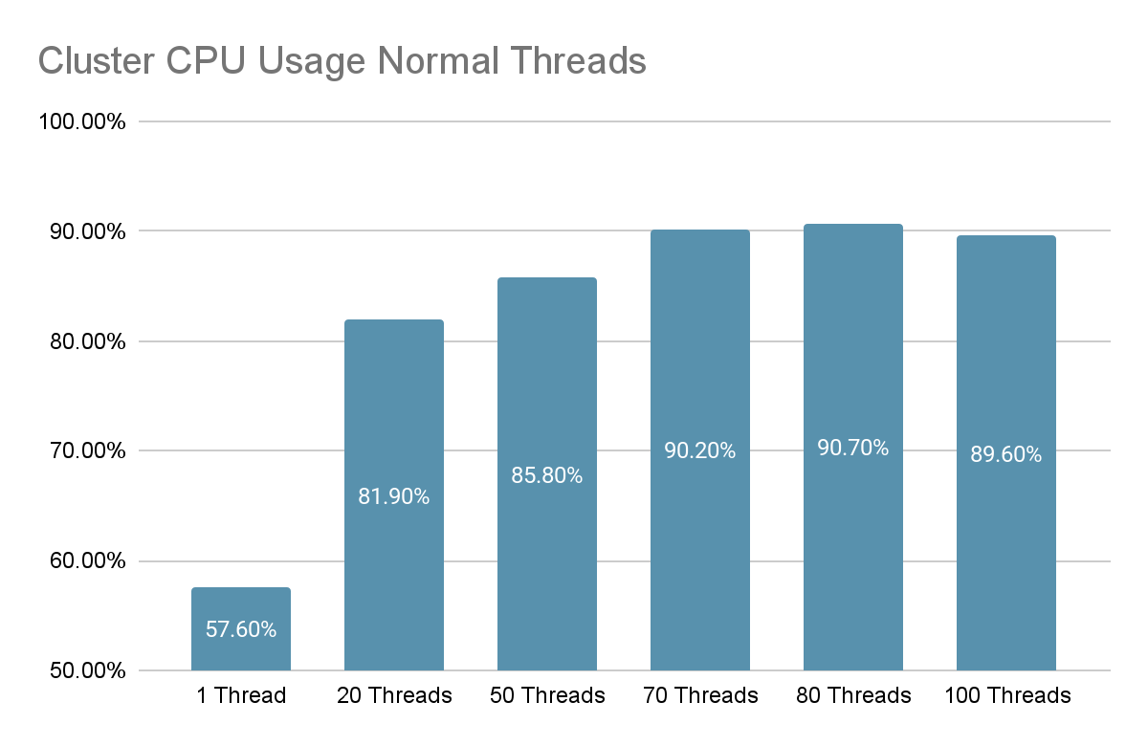

Slide 12
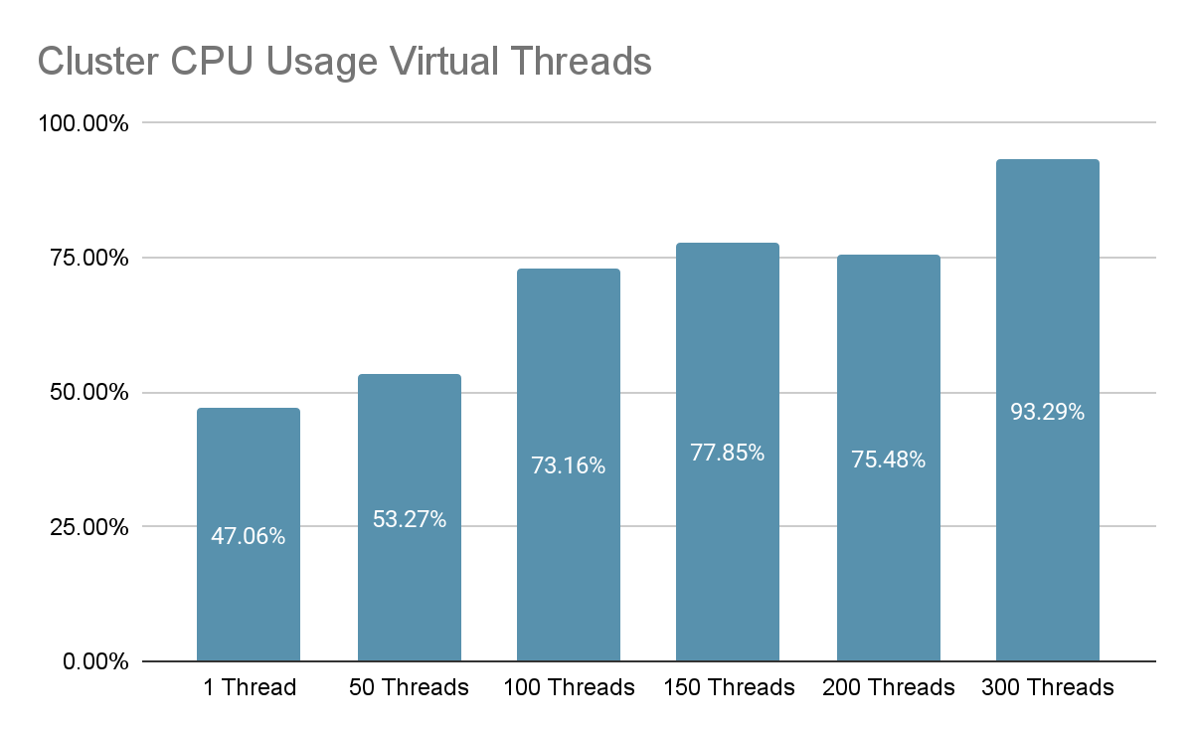

Slide 13
Cluster CPU Usage
Normal Thread
CPU usage increases with thread count.
Near CPU saturation at 80 threads (over 90% usage).
High CPU usage contributes to increased latency.
Virtual Threads
CPU usage is significantly lower at lower thread counts, starting at 47.06% with 1 thread.
Even with higher thread counts, virtual threads show more efficient CPU usage, with a gradual rise to 77.85% at 150 threads.

Slide 14
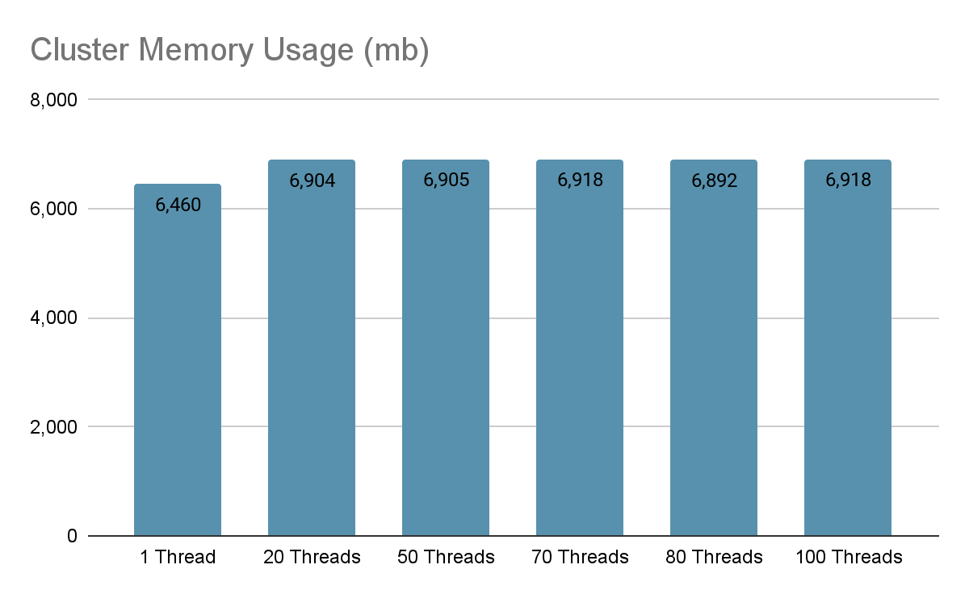

Slide 15
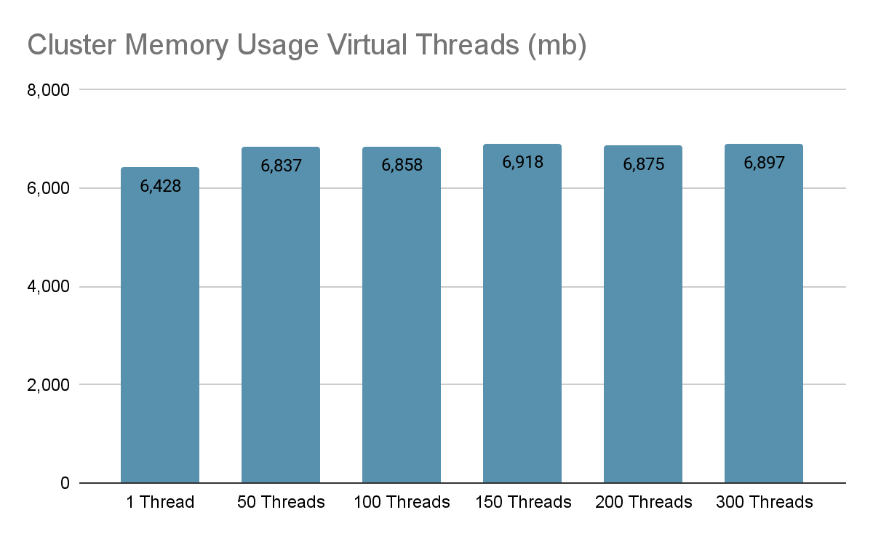

Slide 16
Cluster Memory Usage
Memory usage remains relatively stable across different thread counts.
No significant memory bottlenecks observed.
Suggests that CPU is the primary limiting resource.

Slide 17
Conclusions
Normal Thread
Optimal performance is achieved with a thread count of 50.
Beyond 70 threads, latency increases significantly.
To handle higher concurrency, consider horizontally scaling by adding more nodes or upgrading CPU resources if further concurrency is required.
Virtual Thread
the optimal thread count is 150, allowing the system to efficiently handle a large number of document operations while maintaining CPU usage at 77%.
Virtual threads provide better scalability, with lower latencies and more efficient CPU usage, making them ideal for high-concurrency environments.

